Slide 1


Title : Open-Domain Question Answering
Presenters:
Miss Tahseen Begum – 2010030168
Miss E.Pravallika – 2010030046
Miss N.Sowgna - 2010030344
Miss Keerthana Pulugam - 2010030445
Guide: Dr. Arpita Gupta

Slide 2













Outline
Introduction
Problem Statement
Motivation
Objectives
Flowchart
Literature Survey
Git commits
Pre-processing code and techniques
Alpha Testing
Conclusion
Work Allocation
References
Suggestions

Slide 3
Introduction
Open-ended Open Questionnaire (OpenQA) is an important function in Natural Language Processing (NLP), which aims to answer a question in a natural language based on large informal texts.
Natural language processing (NLP) refers back to the branch of laptop science—and more specifically, the branch of synthetic intelligence or AI—concerned with giving computers the capability to understand textual content and spoken phrases in lots the equal way human beings can.
Sub – domain →Open-domain Question Answering

Slide 4
Problem Statement
Question answering (QA) is a computer science discipline within the fields of information retrieval and natural language processing (NLP), which is concerned with building systems that automatically answer questions posed by humans in a natural language. To accomplish this, we will use a Python library and TensorFlow wrapper that makes deep learning and AI.

Slide 5
Motivation
Aims to answer the question in the form of a natural language based on large informal texts.

Slide 6
Objectives
Objective of the question answering system (QA) is to generate brief answers to the summary questions asked in natural language.
This kind of information retrieval is required with the growth of digital information.
Previously QAS were developed for a specific domain and had limited efficiency.
Present QAS Target on types of questions commonly asked by users, characteristics of data source, and correct answer generated. We aim to build a web-scale QA system
Most QA systems before answer extraction do question classification for predicting entity type of answer of the question.

Slide 7
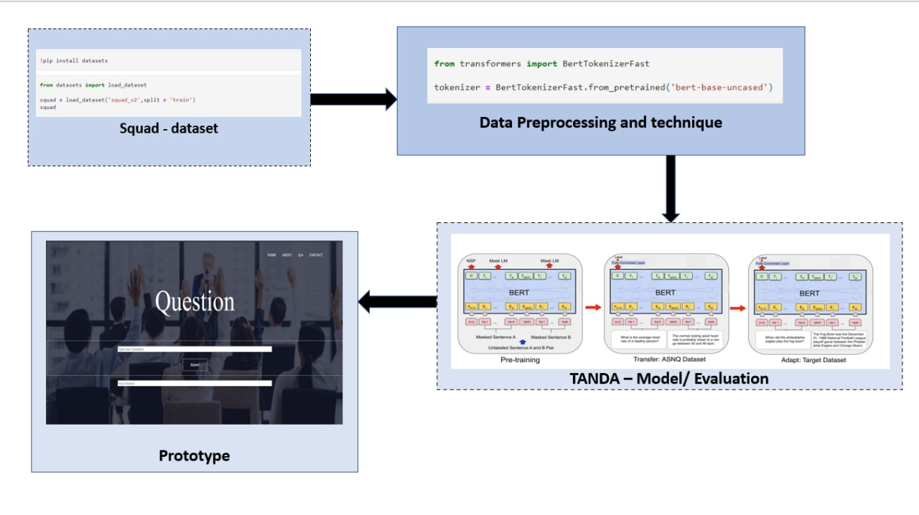
Flowchart

Slide 8
Literature Survey
s.no | Authors | Title | Publishing | Techniques & Dataset | Pros | Cons
1 | Xunlin Zhan, Yinya Huang, Xiao Dong, Qingxing Caoan , Xiaodan Liang | Explainable reasoning paths for commonsense question answering | Received 16 May 2021, Revised 13 October 2021, Accepted 16 October 2021, Available online 29 October 2021 | A reasonable and explainable framework is proposed to explicitly incorporate external reasoning paths with structured information to explain and facilitate commonsense QA. | A path finder and a hierarchical path learner. To answer a commonsense question, the path finder first retrieves explainable reasoning paths from a large-scale knowledge graph, then the path learner encodes the paths with hierarchical encoders and uses the path features to predict the answers. | when dealing with the out-of-scope reasoning target, and are unaware of explainable structured information

Slide 9
s.no | Authors | Title | Publishing | Techniques & Dataset | Pros | Cons
3. | Zechen Guo | Research and Implementation of Open Domain Question Answering System Based on DuReader Dataset and BIDAF Model | 2021 doi:10.1088/1742-6596/1769/1/012033 | This article embeds deep learning technology into the system and uses intelligent chat to show them. | An open domain question answering system aims at returning an answer in response to the user's question. The returned answer is in the form of short texts rather than a list of relevant documents. | when dealing with the out-of-scope reasoning target, and are unaware of explainable structured information
4. | Sharon Levy | Open-Domain Question-Answering for COVID-19 and Other Emergent Domains | [v1] Wed, 13 Oct 2021 18:06:14 UTC (6,650 KB) | we incorporate effective re-ranking and question-answering techniques, such as document diversity and multiple answer spans. Our open-domain question-answering system can further act as a model for the quick development of similar systems that can be adapted and modified for other developing emergent domains. | which we can use to efficiently find answers to free-text questions from a large set of documents. | when dealing with the out-of-scope reasoning target, and are unaware of explainable structured information

Slide 10
S. No | Name of the Dataset | Characteristics | Model | Publisher
4. | SQuAD(Stanford Question Answering Dataset) | In SQuAD, the correct answers of questions can be any sequence of tokens in the given text. Because the questions and answers are produced by humans through crowdsourcing, it is more diverse than some other question-answering datasets. SQuAD 1.1 contains 107,785 question-answer pairs on 536 articles. SQuAD2.0 (open-domain SQuAD, SQuAD-Open), the latest version, combines the 100,000 questions in SQuAD1.1 with over 50,000 un-answerable questions written adversarially by crowdworkers in forms that are similar to the answerable ones. | BertForQuestionAnswering | Rajpurkar date:2019

Slide 11
S. No | Title of the Study | Model | Dataset | Evaluation Criteria | Results | Ref.
5. | TANDA: Transfer and Adapt Pre-Trained Transformer Models for Answer Sentence Selection | TANDA-RoBERTa | WikiQA,TREC-QA,QNLI | We demonstrate the benefits of our approach for answer sentence section, which is a well-known inference task in Question Answering. | TANDA produces an intermediate model with three main features: (i) it can be more effectively used for fine-tuning on the target NLP application, being more stable and easier to adapt to other tasks; (ii) it is robust to noise, which might affect the target domain data; and (iii) it enables modularity and efficiency, i.e., once a Transformer model is adapted to the target general task, e.g., AS2, only the adapt step is needed for each targeted domain | 1175

Slide 12
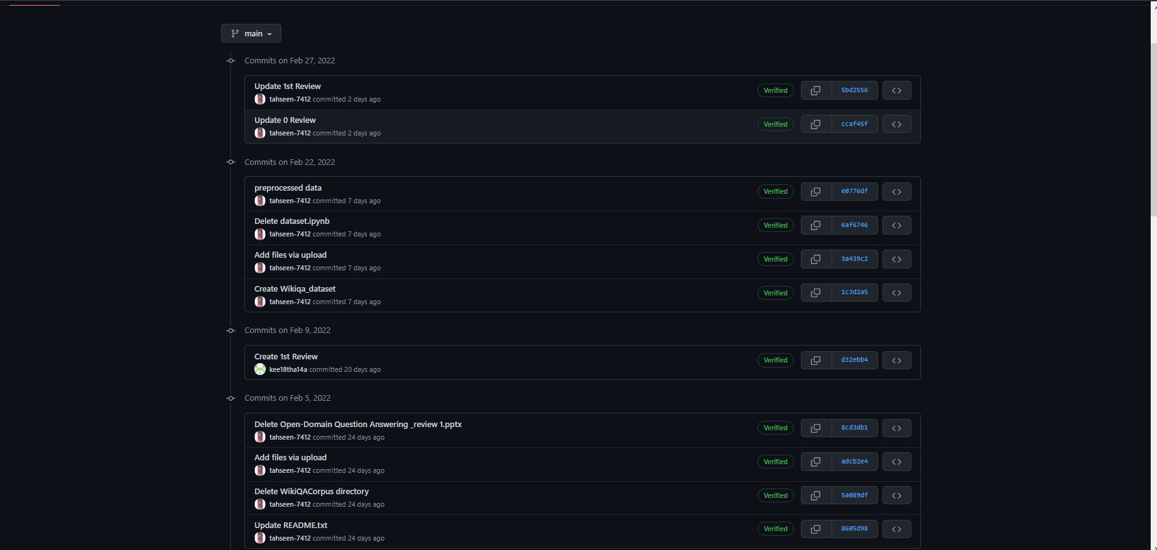
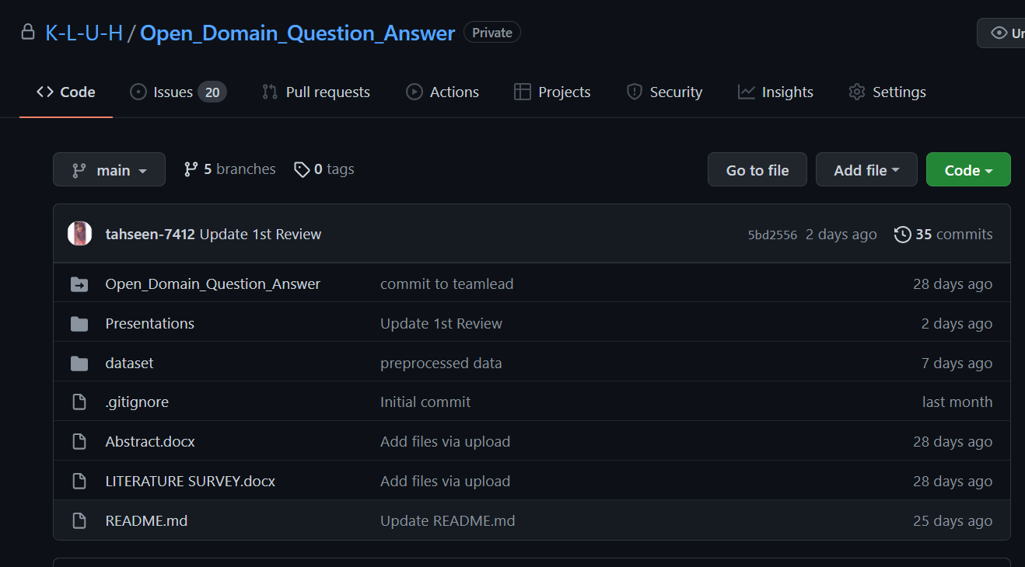
Git commits
(Interval -11 after first review)

Slide 13
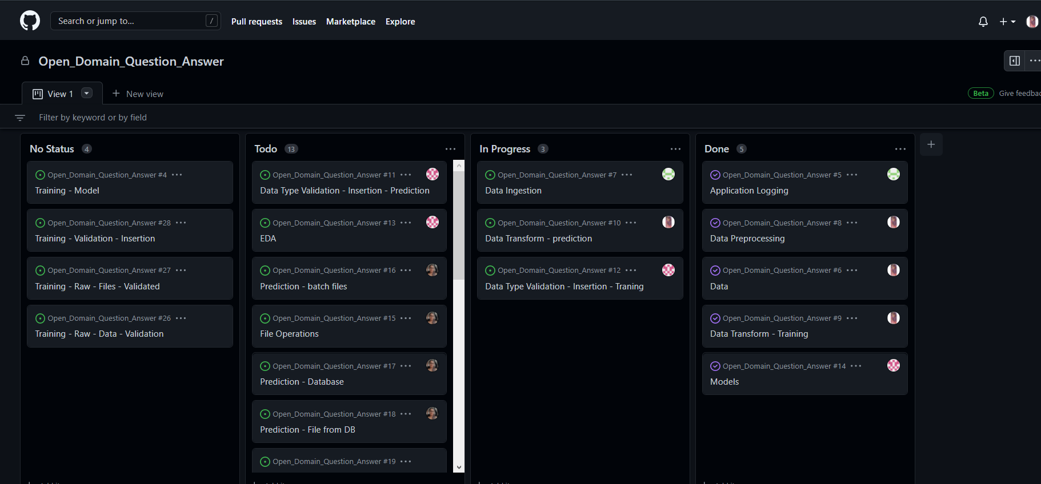
Work in Progress

Slide 14
Pre-processing code and techniques
step1:
!pip install datasets
step2:
from datasets import load_dataset
squad = load_dataset('squad_v2',split = 'train')
Squad
step3:
print(squad[0]['context'][:60])
print(squad[0]['answers']['answer_start'])
step4:
squad[0]['answers']['answer_start'][0] + len(squad[0]['answers']['text'][0])
step5:
squad[0]['context'][269:286]
step6:
context = squad[0]['context']
gold_text = squad[0]['answers']['text'][0]
start_idx = squad[0]['answers']['answer_start'][0]
end_idx = start_idx +len(gold_text)
print(gold_text)
print(start_idx,end_idx)
print(context[start_idx:end_idx])
step7:
squad[2075]
step8:
def get_char_positions(sample):
if len(sample['answers']['text']) == 0:
text = ''
answer_start = 0
answer_end = 0
else:
text = sample['answers']['text'][0]
answer_start = sample['answers']['answer_start'][0]
answer_end = answer_start + len(text)
return {
'text': text,
'answer_start': answer_start,
'answer_end': answer_end
}
squad = squad.map(lambda x: {
'answers': get_char_positions(x)
})

Slide 15
step9:
squad[0]
step10:
!pip install transformers
step11:
from transformers import BertTokenizerFast
tokenizer = BertTokenizerFast.from_pretrained('bert-base-uncased')
step12:
squad = squad.map(lambda x: tokenizer(
x['question'], x['context'], max_length = 384,
padding = 'max_length', truncation = True,
return_offsets_mapping = True
))
step13:
squad[0]
step14:
tokenizer.decode(squad[0]['input_ids'])
step15:
squad[0]['token_type_ids’]
step16:
question_len = 0
for x in squad[0]['token_type_ids']:
if x != 1:
question_len += 1
else:
break
context_len = sum(squad[0]['token_type_ids'])
question_len, context_len
step17:
tokenizer.decode(squad[0]['input_ids'][:question_len])
step18:
tokenizer.decode(squad[0]['input_ids'][question_len:context_len+question_len])
step19:
context_mappings = squad[0]['offset_mapping'][question_len:][:context_len-1]
char_start = squad[0]['answers']['answer_start']
char_end = squad[0]['answers']['answer_end']
for i, mapping in enumerate(context_mappings):
if char_start >= mapping[0] and char_start <= mapping [0]:
token_start = question_len + i
if char_end >= mapping[0] and char_end <= mapping[1]:
token_end = question_len + i + 1
break
if i == len(context_mappings) - 1:
token_start, token_end = 0, 0
break
squad[0]['answers']['text']

Slide 16
step20:
squad
step21:
squad = squad.remove_columns(['id','title','context','question','answers','offset_mapping'])
squad
step22:
!pip install transformers
step23:
from transformers import BertForQuestionAnswering
model = BertForQuestionAnswering.from_pretrained('bert-base-uncased')
step24:
from transformers import TrainingArguments
batch_size = 24
epochs = 3
args = TrainingArguments(
'bert-base-uncased-squad2',
learning_rate=2e-5,
per_device_eval_batch_size=batch_size,
num_train_epochs=epochs,
weight_decay=0.1,
warmup_steps=int(len(squad) * epochs * 0.1)
)
from transformers import default_data_collator
data_collator = default_data_collator
import torch
print(torch.cuda.is_available)
from transformers import Trainer
import torch
device = 'cuda : 0' if torch.cuda.is_available() else 'cpu'
trainer = Trainer(
model.to(device),
args,
train_dataset = squad,
data_collator = data_collator,
tokenizer = tokenizer
)
trainer.train()

Slide 17
Alpha Testing
<!---------- call to action-------->
<center>
<section class="cta">
<h1>Team Contact</h1>
<a href="" class="hero-btn">CONTACT US</a>
</section>
<!----- footer ---------->
<section class="footer">
<h4>About Us</h4>
<p>Students from koneru lakshmaiah education foundation hyderabad</p>
<div class="icons">
<i class="fa fa-facebook"></i>
<i class="fa fa-twitter"></i>
<i class="fa fa-instagram"></i>
<i class="fa fa-linkedin"></i>
<i class="fa fa-github"></i>
</section>
</center>
<!-----JavaScript for Toggle Menu----->
<script>
var navLinks = document.getElementById("navLinks");
function showMenu(){
navLinks.style.right = "0";
}
function hideMenu(){
navLinks.style.right = "-200px";
}
</script>
</body>
</html>
<!DOCTYPE html>
<html>
<head>
<meta name="viewport" content="with=device-width, initial-scale=1.0">
<title>Open Domain Question And Answer</title>
<link rel ="stylesheet" href="style.css">
<link rel="preconnect" href="https://fonts.googleapis.com">
<link rel="preconnect" href="https://fonts.gstatic.com" crossorigin>
<link rel="stylesheet" href="https://stackpath.bootstrapcdn.com/font-awesome/4.7.0/css/font-awesome.min.css">
</head>
<body>
<section class="header">
<nav>
<div class="nav-links" id="navLinks">
<i class="fa fa-times-circle" onclick="hideMenu()"></i>
<ul>
<li><a href="index.html">HOME</a></li>
<li><a href="about.html">ABOUT</a></li>
<li><a href="QA.html">Q/A</a></li>
<li><a href="contact.html">CONTACT</a></li>
</ul>
</div>
<i class="fa fa-bars" onclick="showMenu()"></i>
</nav>
<div class="text-box">
<p>Open Domain Question And Answer</p>
<a href="" class="hero-btn">Click here to ask Question</a>
</div>
</section>

Slide 18
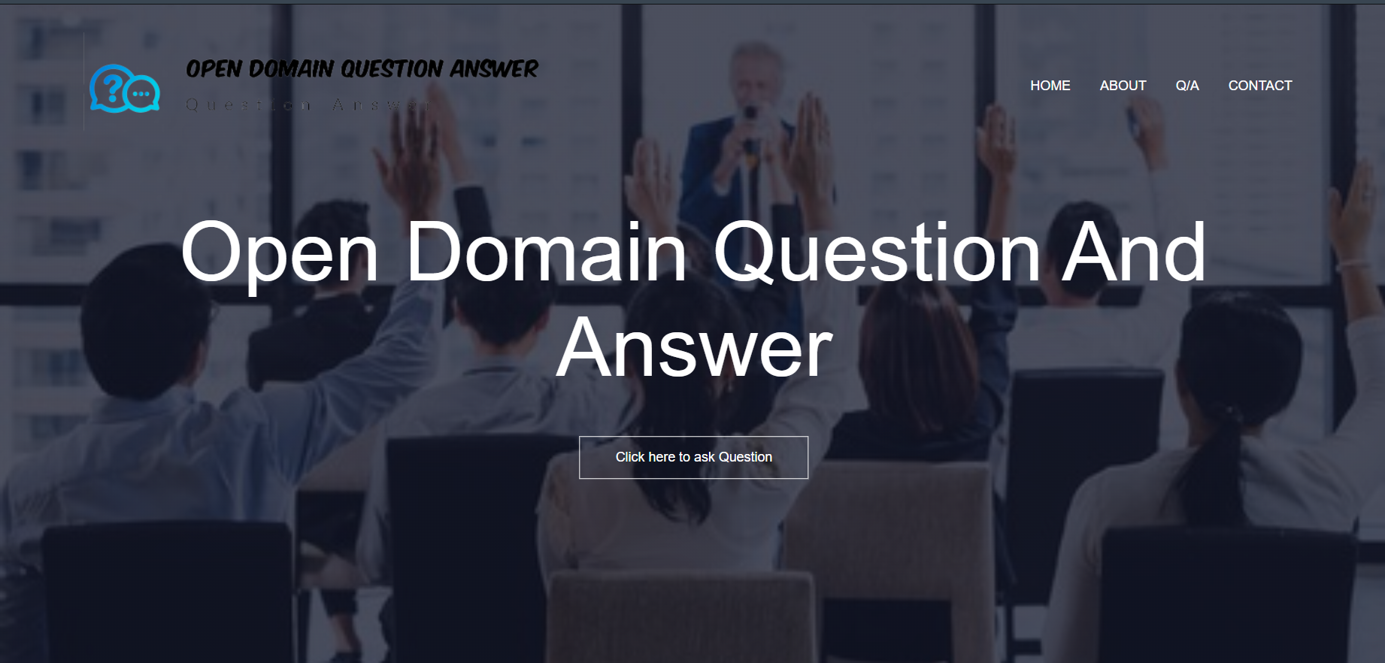

Slide 19
Conclusion
We have completed the front-end for this project.
Next we will work on the back-end.
The question answering system to produce relevant, correct, and complete answers to the point.
Hence many evaluation metrics were developed to measure such ambiguous terminologies.

Slide 20
Work Allocation
Preprocessing code and Techniques – Tahseen Begum
Alpha Testing – E. Pravallika and N. Sowgna
Documentation, PowerPoint, Flowchart– N. Sowgna, Keerthana

Slide 21
Reference
Liu, Qian, Bei Chen, Jiaqi Guo, Zeqi Lin, and Jian-guang Lou. "TAPEX: Table pre-training via learning a neural SQL executor." arXiv preprint arXiv:2107.07653 (2021).
Hu, Zhe, Zuohui Fu, Cheng Peng, and Weiwei Wang. "Enhanced Sentence Alignment Network for Efficient Short Text Matching." In Proceedings of the Sixth Workshop on Noisy User-generated Text (W-NUT 2020), pp. 34-40. 2020.
Soldaini, Luca, and Alessandro Moschitti. "The cascade transformer: an application for efficient answer sentence selection." arXiv preprint arXiv:2005.02534 (2020).
Shi, Qi, Qian Liu, Bei Chen, Yu Zhang, Ting Liu, and Jian-Guang Lou. "LEMON: Language-Based Environment Manipulation via Execution-Guided Pre-training." arXiv preprint arXiv:2201.08081 (2022).
Matt Crane. 2018. Questionable answers in question answering research: Reproducibility and variability of published results. Transactions of the Association for Computational Linguistics, 6:241–252.
Guo, Zechen, Fucheng Wan, and Ning Ma. "Research and Implementation of Open Domain Question Answering System Based on DuReader Dataset and BIDAF Model." In Journal of Physics: Conference Series, vol. 1769, no. 1, p. 012033. IOP Publishing, 2021.
Levy, Sharon, Kevin Mo, Wenhan Xiong, and William Yang Wang. "Open-Domain Question-Answering for COVID-19 and Other Emergent Domains." arXiv preprint arXiv:2110.06962 (2021).
Zhan, Xunlin, Yinya Huang, Xiao Dong, Qingxing Cao, and Xiaodan Liang. "PathReasoner: Explainable reasoning paths for commonsense question answering." Knowledge-Based Systems 235 (2022): 107612.
Lee, Chia-Hsuan, Shang-Ming Wang, Huan-Cheng Chang, and Hung-Yi Lee. "ODSQA: Open-domain spoken question answering dataset." In 2018 IEEE Spoken Language Technology Workshop (SLT), pp. 949-956. IEEE, 2018.
Yang, Yi, Wen-tau Yih, and Christopher Meek. "Wikiqa: A challenge dataset for open-domain question answering." In Proceedings of the 2015 conference on empirical methods in natural language processing, pp. 2013-2018. 2015.
Herzig, Jonathan, Paweł Krzysztof Nowak, Thomas Müller, Francesco Piccinno, and Julian Martin Eisenschlos. "TaPas: Weakly supervised table parsing via pre-training." arXiv preprint arXiv:2004.02349 (2020).
Moon, Sungrim, Huan He, Hongfang Liu, and Jungwei W. Fan. "RxWhyQA: a clinical question-answering dataset with the challenge of multi-answer questions." arXiv preprint arXiv:2201.02517 (2022).
Antoniou, Christina, and Nick Bassiliades. "A survey on semantic question answering systems." The Knowledge Engineering Review 37 (2022).
Hao, Tianyong, Xinxin Li, Yulan He, Fu Lee Wang, and Yingying Qu. "Recent progress in leveraging deep learning methods for question answering." Neural Computing and Applications (2022): 1-19.
Yuan, Bowen, Bairu Chen, Zhiyi Tan, Xi Shao, and Bing-Kun Bao. "Unbiased feature enhancement framework for cross-modality person re-identification." Multimedia Systems (2022): 1-11.

Slide 22

Suggestions

